Slide 1

CVR COLLEGE OF ENGINEERING (An Autonomous Institution, NAAC Accredited and Affiliated to JNTU, Hyderabad) Vastunagar, Mangalpalli (V), Ibrahimpatnam (M), Rangareddy (D), Telangana- 501 510 DEPARTMENT OF CSE (DATA SCIENCE) B.Tech II Year II Semester Real-Time/Field - Based Research Project Review - 0

Slide 2
Online Auction System for Gadgets
By
Student1: J.Hemanth Naga Sai Kumar(23B81A6781)
Student2: N.Rushikesh (23B81A67A0)
Student3: B.Sai Teja (23B81A67A4)
Under the guidance of
Mr. Ahmed Shahebaaz

Slide 3
Abstract: Overview of a web-based platform facilitating the buying and selling of gadgets through an auction model. Features include real-time bidding, an auto-bidding system, a countdown timer for auctions, and a secure payment gateway. Emphasis on user authentication, live notifications, and an admin dashboard for managing auctions. Goal: To provide a transparent, efficient, and secure platform for gadget enthusiasts and sellers.

Slide 4
Problem Statement:
Challenges in the Current Market:
Limited access to rare or exclusive gadgets.
Direct purchases with inflated prices.
Lack of an organized, competitive bidding system.
Need:
A structured online auction system to promote fair pricing and accessibility.

Slide 5
Existing works/methods and challenges:
Existing Platforms:
Traditional online marketplaces
Auction sites with outdated interfaces
Limitations:
High transaction fees
Inconsistent user experiences
Security vulnerabilities

Slide 6
Proposed Method:
Description
Implement an online auction platform for fair and competitive pricing.
Provide real-time bidding with notifications.
Ensure secure transactions and user verification.

Slide 7
Architecture diagram:

Slide 8
Technology Stack:
Software Requirements:
- Frontend: HTML, CSS, JavaScript
Backend: PHP / Python Flask
Database: MySQL / SQLite
Hosting: Localhost / Free Cloud Hosting
Hardware Requirements:
Processor: Intel Core i5 or higher
RAM: 8GB or higher
Storage: 10GB SSD or higher
Internet Connection: High-speed broadband

Slide 9
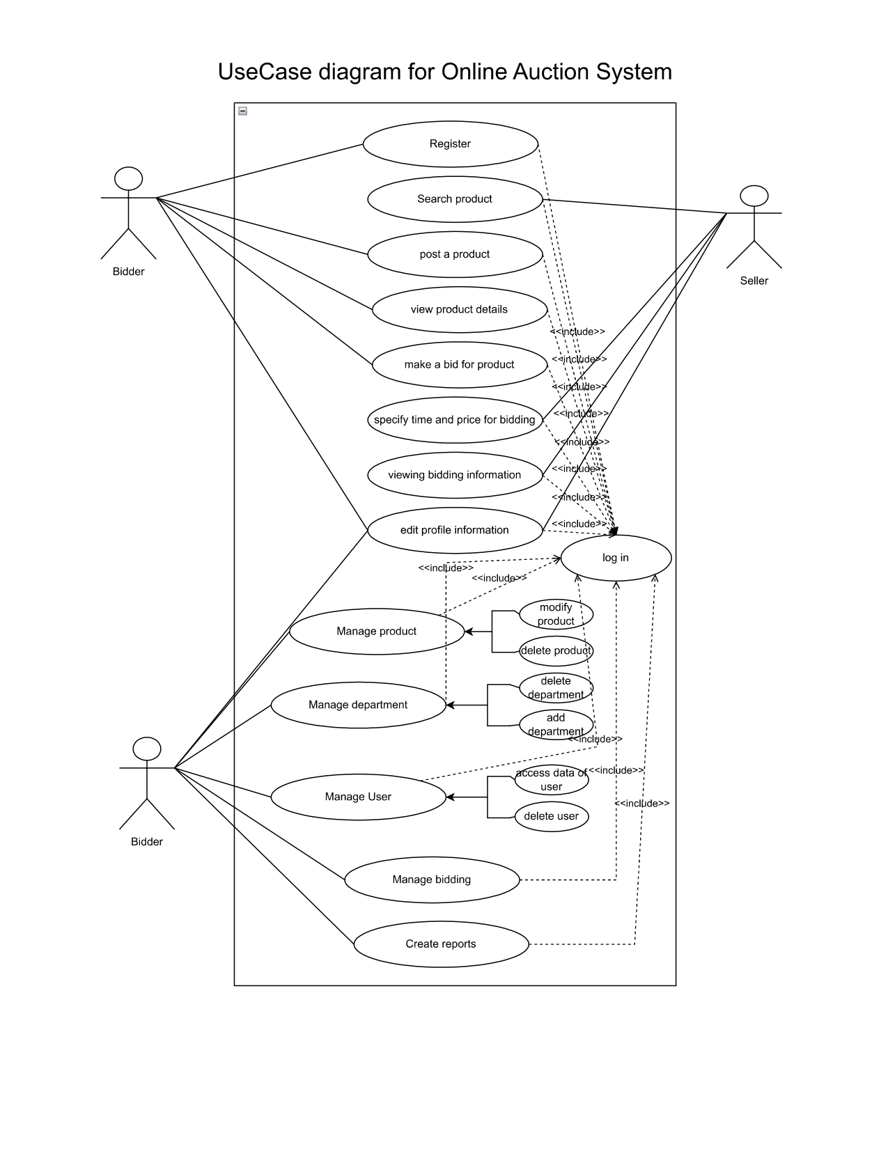
Use-Case/Data Flow Diagram:

Slide 10
Thank You

